Slide 1
Manner Path Priming
Harvard Laboratory for Developmental Studies, Summer 2016

Slide 2

Background
Across languages, most verbs encode either path (what happens, e.g. entering a room) or manner (how it happens, e.g. by dancing) of an event.
Adults have biases about whether verbs are likely to encode manner or path depending on their native language; these biases are abstract and can be altered with experience.
For example, if adults are exposed to many novel verbs that encode manner, they develop an action bias and predict future new words will also encode manner
Some evidence that this manner-path bias can be extended to action and effect.

Slide 3
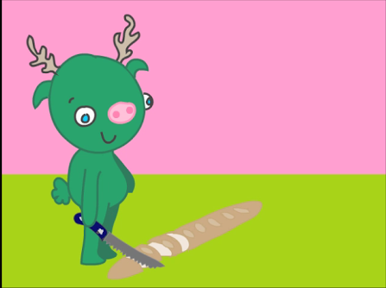
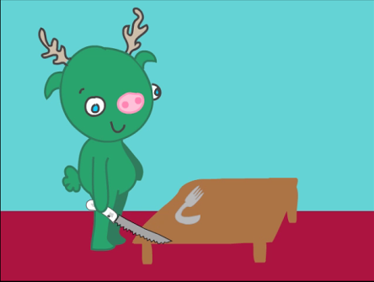
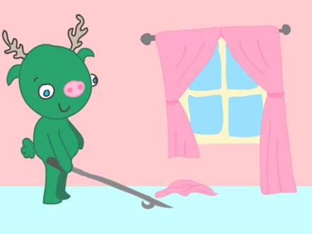
Experiment
How do children’s action/effect biases develop?
Participants 4-5 years old
“The monster is going to blick the bread.”
“Which one is blicking?”

Slide 4
Experiment
Bias Test
Action-Effect trials
Bias test
Evidence: Novel words as evidence for either action or effect
Test trial: Shown another video and asked whether the novel word corresponds to action or effect
Evidence
Action
Effect
Test Trial

Slide 5
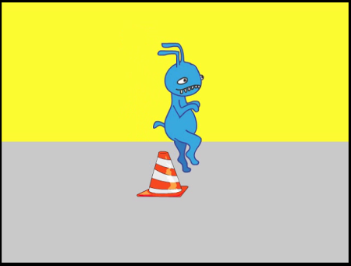
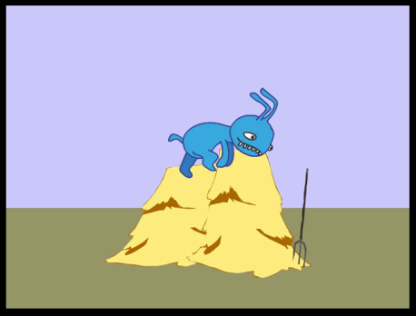
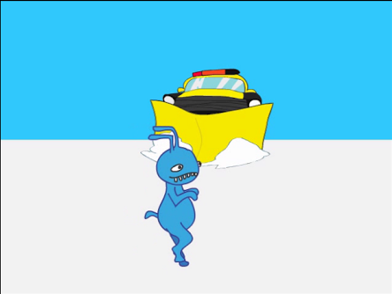
Experiment
Manner-Path test trials
Shown one video in each and asked whether the novel word corresponds to manner or path.
“The monster is going to burk over the cone.”
“Which one is burking?”

Slide 6
Predictions
As experiment progresses, participants are expected to develop a bias depending on the condition they are exposed to (action or effect)

Slide 7
Predictions
Action
Effect

Slide 8
Predictions
As experiment progresses, participants are expected to develop a bias depending on the condition they are exposed to (action or effect)
This bias will affect their prediction of the meanings novel words in the manner-path test trials.
Action → Manner
Effect → Path

Slide 9
Predictions
Action
Effect

